Slide 1
Welcome to SDZ’s Python Workshop #3
By Riko Hamblin and Ibukun Oluwayomi

Slide 2
Data Structures
Used to:
Store information/data in a meaningful way
Model data as close to real-world as possible e.g. if you have 300 numbers and you want to store them for further processing then keep these numbers in a list

Slide 3
List Example
Consider a scenario where we want to store 5 numbers. One way is to just create 5 variables to store the numbers:
var1 = 9
var2 = 7
var3 = 0
var4 = 12
var5 = 1
However, if we have to store 5000 integers it would be unrealistic to use 5000 variables. In addition, we will forget their names easily!

Slide 4

How to use Lists in Python
This is where lists come in handy. A list is a collection of items. These items are ordered in memory so that it is easy to retrieve any of them.
Let’s say we have a list of cars or a list of colours. How do we store them efficiently in memory?
colours = ['red’, 'blue', 'green']
cars = ['Toyota', 'Honda', 'Ford']
print cars[0] ## Toyota
print cars[2] ## Ford
print len(cars) ## 3

Slide 5
List Comprehension
Python also supports computed lists, called list comprehensions
In its simplest form, a list comprehension has the following syntax:
L = [expression for variable in sequence]
# lets create a list containing the numbers 0 to 40
numbers = [1,2,3,4,5,6,7,8,9,10, "I am tired of typing :( "]
print numbers

Slide 6
List Comprehension
numbers = [i for i in range(40)] print numbers # what does this do? Remember that range()creates a sequence of numbers. # each of those numbers is appended to our list
# or we could have done it this way. twos = [] # create an empty list first for i in range(50): twos.append(2) # append 2 to the list 50 times. print twos

Slide 7
List Comprehension
LET’S WRITE SOME CODE

Slide 8
Dictionary
A dictionary :
Operates like a list where we can use anything to identify an element. However it is unordered in memory.
Creates Key-Value mappings.
Interchangeable with terms like: Lookup Table, Hash-Map

Slide 9
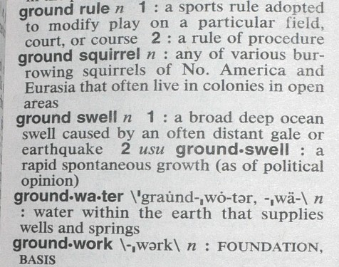
Dictionary
Think of how an ACTUAL dictionary is structured:
KEY: Word
VALUE: Definition

Slide 10
Dictionary
Let’s write some code!

Slide 11
Dictionary
Let’s modify our original Address Book so that we are using dictionaries!

Slide 12
Remember
[ ] when defining lists
{ } when defining Dictionaries

Slide 13
Congratulations
We finished our workshop!

